Slide 2
American
Nitrile
Today
We built our own production facility in Ohio, the traditional home of the US rubber industry
State-of-the-art 530,000 Sq. ft plant and equipment featuring automated packaging
12 High Speed dual former lines able to produce 30M gloves per line, per month. 3.6 Billion gloves annually
510K with Chemo and Fentanyl rating
AQL (Acceptable Quality Level) of 1.5 is the Gold standard of excellence for nitrile gloves
Compression fit technology Q2 2023

Slide 3
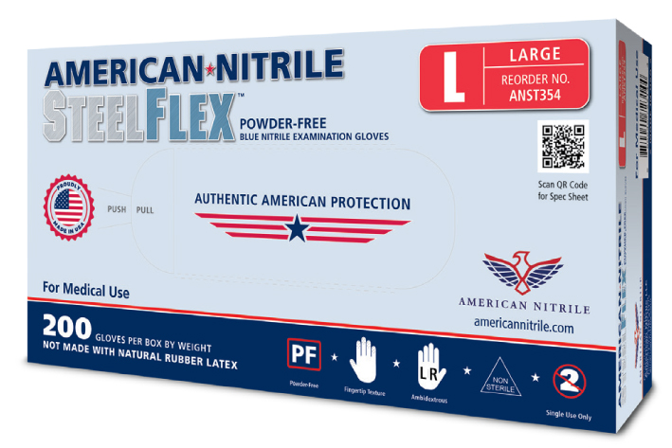
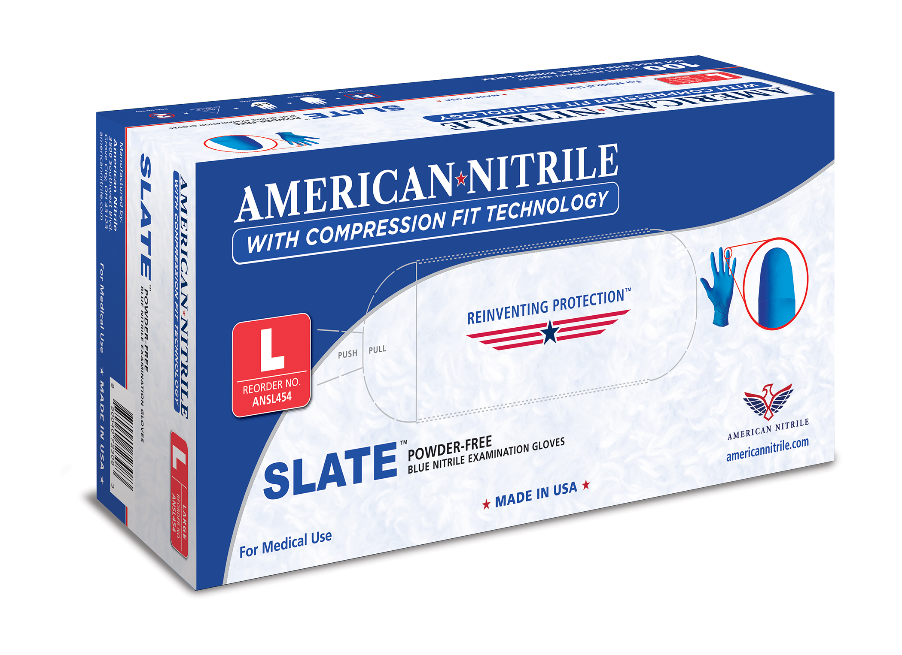
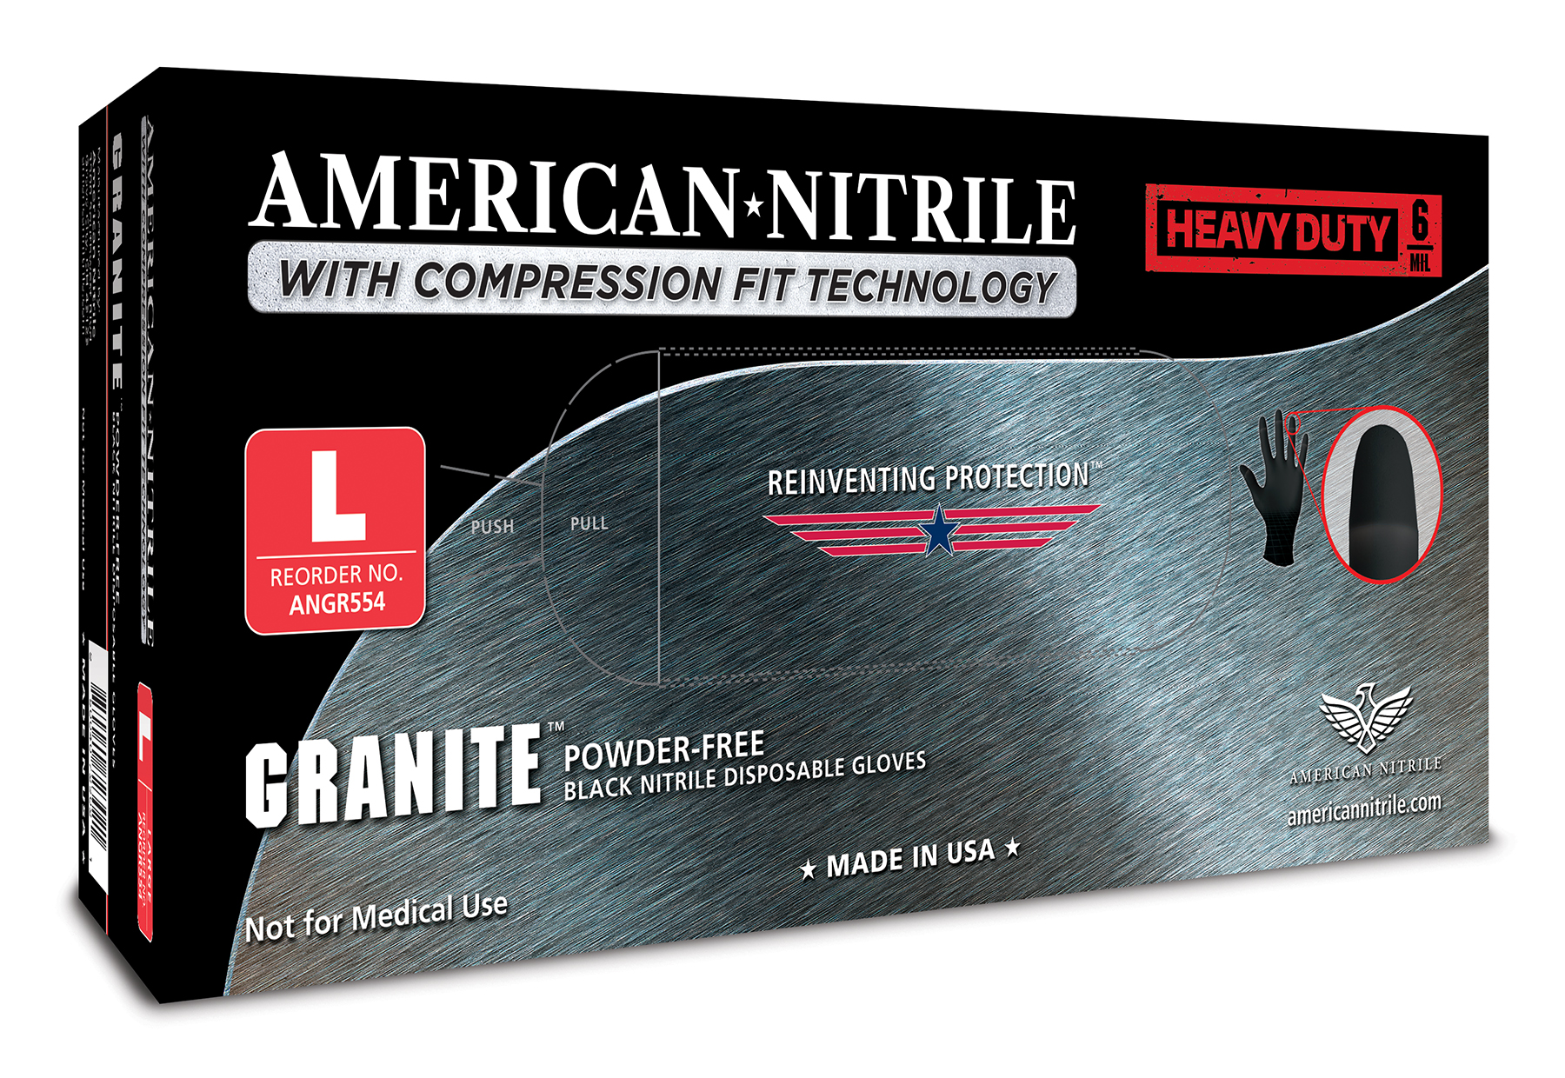
Our Products
STEELFLEX
SLATE
GRANITE
Medical/Exam Room
Laboratory/Research
Industrial
3.5 mil
Complies with ASTM standards
Cleared for use with chemotherapy drugs in accordance with ASTM D6978
Enhanced Sensitivity
Reduced Allergens
1.5 Superior AQL
4.7 mil
Complies with ASTM standards
Cleared for use with chemotherapy drugs in accordance with ASTM D6978
Smooth inner surface for easy donning
Exceptional grip
Touchscreen friendly
1.5 Superior AQL
6.3 mil
ASTM F739 for chemical splash protection use and ASTM F1342 for puncture resistance.
Natural feel minimizes muscle fatigue
Black color to identify grease, powder and other substances
Touchscreen friendly
2.5 Superior AQL

Slide 4
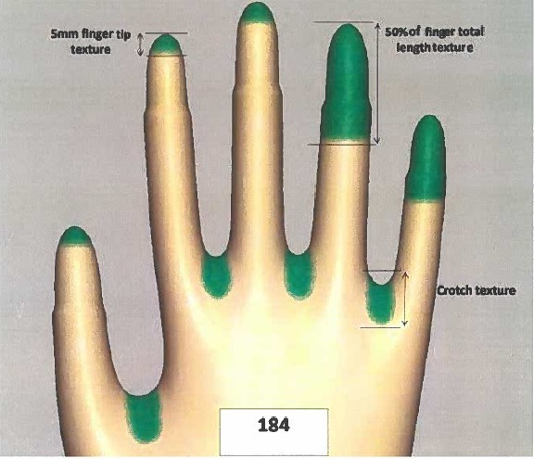
Nitrile Glove Innovation Hub
American Nitrile will be an innovation hub for nitrile glove research & development
Glove R&D has been limited in the previous decade, with most of the innovation coming in the production process rather than the product
American Nitrile plans to roll out new product improvements
Product Innovation: Compression Fit Fingertip Gloves
American Nitrile has partnered with a US-based technology expert for an exclusive license to produce and market this unique glove feature in the US
These gloves are narrower at the fingertip, providing significantly improved dexterity for end users
This is a critical distinction for anyone that require precision, including but not limited to dentists, lab techs, EMS workers, and mechanics
Compression fit gloves will be an AN Exclusive with 20 Year Patent with future improvement

Slide 5
SUSTAINABILITY
SOLUTION
Growing The Right Way
State-of-the-art water treatment and recycling plant saving 40 gallons of water per case of gloves, 150M gallons annually
$16M investment
60%+ greater efficiency versus outdated technology
Proximity to US customers, eliminating oceanic shipping
Sustainability is at the core of what we do.

